Slide 1

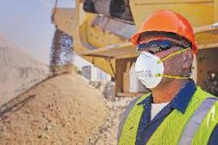
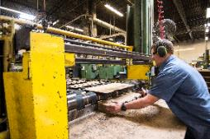
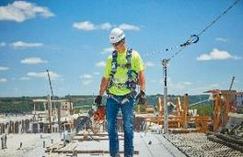
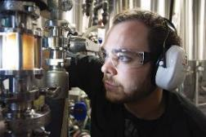
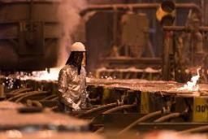
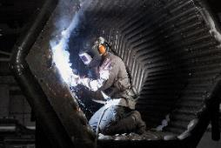
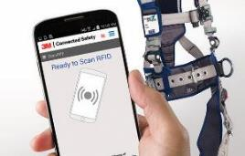
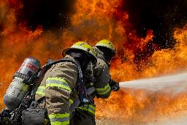
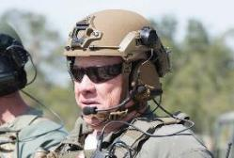
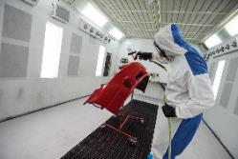
^{Respiratory Protection}
^{Hearing} ^{Protection}
^{Fall Protection}
^{Protective} ^{Eyewear}
^{Head and Face Protection}
^{Welding Safety}
Connected Safety Software Solutions
^{SCBA & Fire}
^{Protective Communications}
^{Protective} ^{Apparel}
Complete safety solutions from Brands you trust

Slide 2
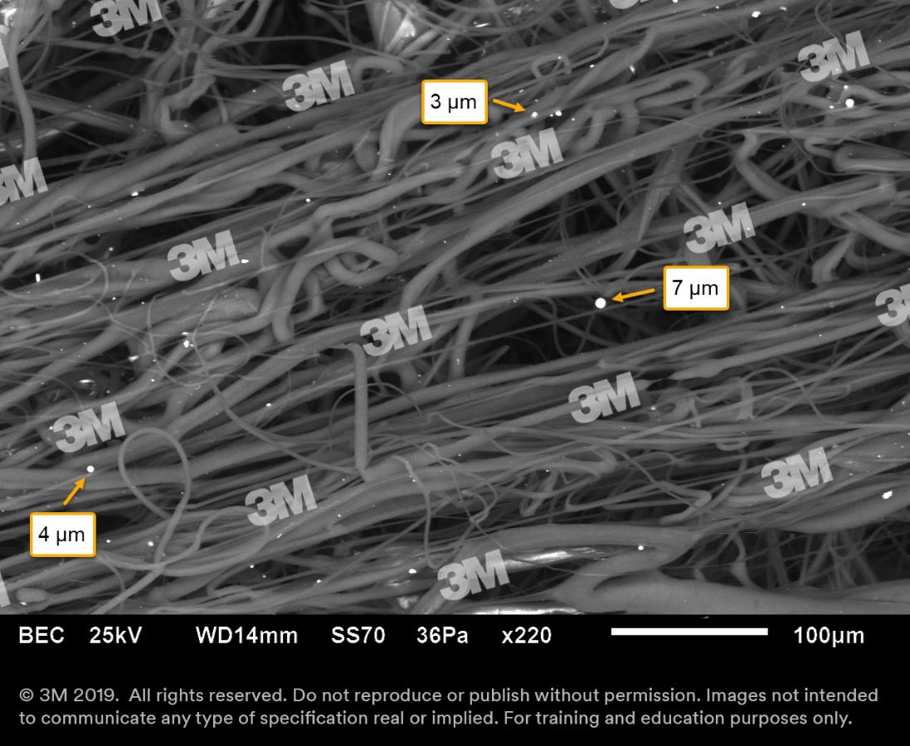
AS/NZS 1716 Particulate Filter Ratings
P1 for mechanically generated particles
eg silica, wood dust
P2 for mechanically & thermally generated particles
e.g. metal fumes & smokes
P3 for all particulates including highly toxic materials
e.g. beryllium
AS/NZS 1715 Test aerosol size 0.3-0.6µm
Notes:
Mark

Slide 3
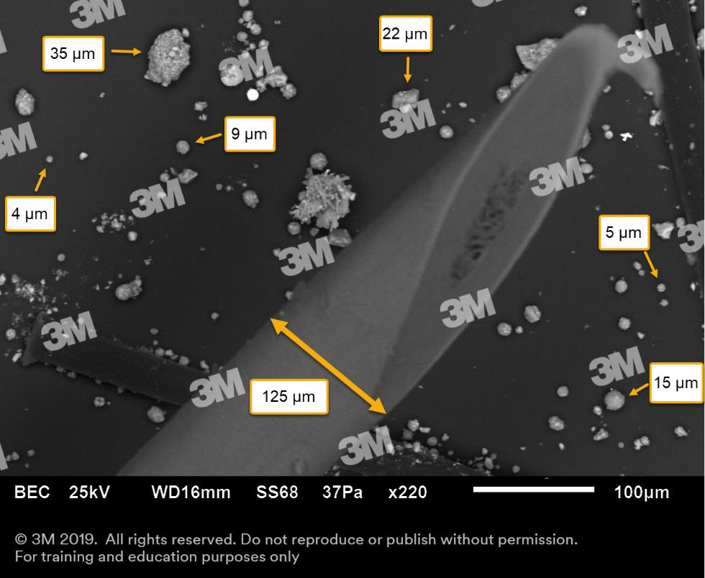


Slide 4
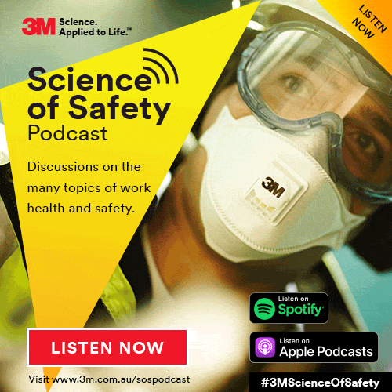
Contact Details: Mark Reggers 0428 720 159 mreggers@mmm.com Leanne Atkins 0435 000 494 latkins2@mmm.com
Questions?

